Slide 1
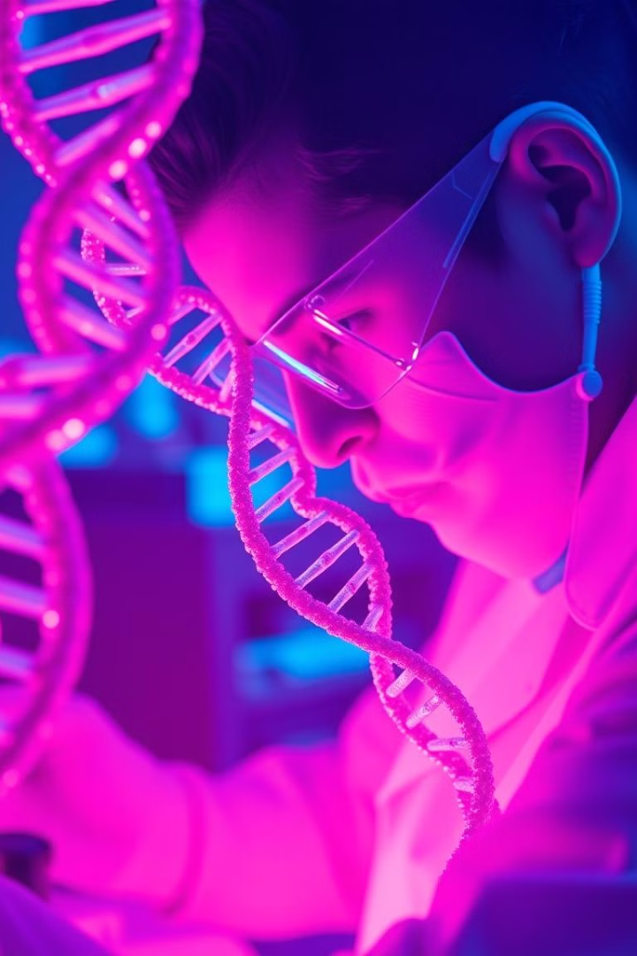
Biotechnology and CRISPR: Revolutionizing Genetic Engineering
This presentation explores the fundamentals of biotechnology and the revolutionary CRISPR technology, highlighting their growing relevance in medicine, agriculture, and beyond.
by Sumedh Kedari

Slide 2
What is Biotechnology?
Definition
Applications
Biotechnology involves utilizing living systems and organisms to develop or produce products.
Agriculture: Genetically modified crops (GMOs) for pest resistance and increased yield (e.g., Bt corn).
Medicine: Production of insulin for diabetes treatment using genetically engineered bacteria.
Environmental Science: Bioremediation using microbes to clean up pollutants (e.g., oil spills).
Industrial Processes: Enzyme production for detergents and biofuels.

Slide 3

Understanding the Basics of CRISPR
CRISPR stands for "Clustered Regularly Interspaced Short Palindromic Repeats." This technology is revolutionizing genetic engineering by allowing scientists to precisely edit DNA sequences. The CRISPR-Cas9 system is a key player in this revolution.
1
Cas9
2
Guide RNA (gRNA)
An enzyme acting like molecular scissors, cutting DNA at specific locations.
A short RNA sequence that guides Cas9 to the target DNA sequence.

Slide 4
The CRISPR-Cas9 System: How It Works
Step 1
Designing the gRNA to match the target DNA sequence.
Step 2
Introducing the CRISPR-Cas9 system into the cell.
Step 3
The gRNA guides Cas9 to the target DNA.
Step 4
Cas9 cuts both strands of the DNA.
Step 5
The cell repairs the break either by non-homologous end joining (NHEJ) or homology-directed repair (HDR).

Slide 5

Applications of CRISPR: Medicine
Gene Therapy
Cancer Treatment
Infectious Diseases
Correcting genetic defects in diseases like cystic fibrosis and sickle cell anemia. Example: Clinical trials using CRISPR to edit the gene responsible for sickle cell anemia show promising results in reducing the need for blood transfusions.
Engineering immune cells to target and destroy cancer cells. Example: CAR-T cell therapy involves modifying T cells with CRISPR to recognize and kill cancer cells more effectively.
Developing new diagnostics and treatments for viral infections like HIV. Example: Researchers are using CRISPR to target and destroy HIV DNA in infected cells.

Slide 6

Applications of CRISPR: Agriculture
1
Crop Improvement
2
Livestock Breeding
3
Sustainable Agriculture
Enhancing traits like yield, disease resistance, and drought tolerance. Example: Developing rice varieties that are resistant to bacterial blight, a major threat to rice production.
Improving traits like disease resistance, muscle growth, and milk production in animals. Example: Using CRISPR to create cattle that are resistant to bovine tuberculosis.
Reducing the need for pesticides and fertilizers, leading to more environmentally friendly agricultural practices.

Slide 7

Ethical Considerations of CRISPR Technology
Germline Editing
Social Equity
Concerns about making permanent changes to the human genome that can be passed on to future generations. The potential for unintended consequences and off-target effects.
Ensuring that CRISPR technology is accessible to all and does not exacerbate existing inequalities.
Regulation and Oversight
The need for clear guidelines and regulations to govern the use of CRISPR technology, ensuring responsible development and application.

Slide 8

The Future of CRISPR
1
Advancements in CRISPR Technology
Developing more precise and efficient CRISPR systems, expanding the range of applications for CRISPR.
2
Potential Breakthroughs
Curing genetic diseases, creating more sustainable and resilient agricultural systems, developing new diagnostic tools and therapies for a wide range of diseases.

Slide 9
Benefits and Drawbacks of Biotechnology and CRISPR
Benefits
Drawbacks
Revolutionizing medicine and curing diseases.
Ethical considerations related to germline editing and its potential for unintended consequences.
Sustainable food production, increasing yields and reducing environmental impact.
Concerns about the potential for creating genetic disorders in future generations.
Reducing carbon footprint through advancements in biofuel production and environmental remediation.
The need for stringent regulation and oversight to ensure responsible and ethical use.

Slide 10
Thank You!
I appreciate your time and attention. I trust this presentation offered a comprehensive and insightful look into biotechnology and CRISPR technology.
Please don't hesitate to contact me if you have any inquiries or would like to discuss this topic further: your_email@example.com

